Slide 1
ENGLISH LEXICON
Application of Binary Search Tree

Slide 2
GROUP- 10 MEMBERS
Aditi Agrawal- 03401012019
Balpreet Kaur- 05201012019
Jaskiran Kaur - 05301012019
Heena Ahmed- 05401012019
Saumya Jangid- 07301012019

Slide 3
OUR OBJECTIVE
To Implement English Lexicon Using Binary Search Tree

Slide 4
What is a binary Search Tree ?
Binary Search Tree is a recursive tree data structure which has the following properties:
The left subtree of a node contains only nodes with keys lesser than the node’s key.
The right subtree of a node contains only nodes with keys greater than the node’s key.
The left and right subtree each must also be a binary search tree.

Slide 5
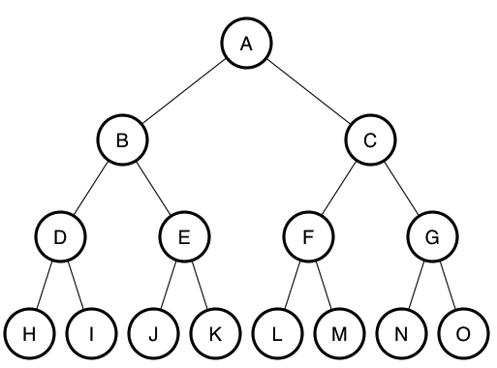

Slide 6
How to Implement Dictionary Using a BST?
Dictionaries can be implemented using a binary search tree. A binary search tree is a binary tree such that each node stores a key of a dictionary.
Key 'K' of a node is always greater than the keys present in its left sub tree.
Similarly, the key 'K' of a node is always lesser than the keys present in its right subtree.
Implementation of lexicon - which will read a list of words and their definitions. Users can look for their meaning an their synonyms and antonyms. Insertion of new words, searching and deletion can also be performed. We are using the concepts of data structures such as trees, arrays ,linked lists etc.

Slide 7
Some of the Modules of our Project include:
Creation of words
Insertion of words
Display of words
Deletion of words
Searching a word
Total words in the lexicon
Editing a word

Slide 8
CREATION OF NEW NODE
This function is used to create a new node of binary search tree such that each node stores a key(i.e word along with its meaning, antonym and synonym) of a dictionary.
The memory to the new node is allocated dynamically using the malloc function. Any number of nodes can be created and linked to the existing node.

Slide 9
ALGORITHM (Pseudo Code)
Creation of new node
struct BSTnode * createNode(char *word, char *meaning, char *synonym, char *antonym)
{
1. struct BSTnode *newnode
2. Allocate the memory to the newnode dynamically using the malloc function
newnode = (struct BSTnode *)malloc(sizeof(struct BSTnode))
3. Assign the values to the respective fields of newnode using the strcpy function
strcpy(newnode->word, word)
4. Set Left and Right pointers of newnode = NULL
newnode->left = newnode->right = NULL;
5. return newnode;
}

Slide 10
TIME AND SPACE COMPLEXITY
The time complexity for new node creation is O(1) in both average and worst case.
The space complexity for new node creation is O(1) in both average and worst case.

Slide 11
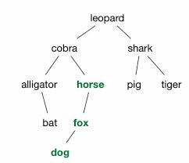
INSERTION OF WORDS IN THE DICTIONARY
This function inserts the word in the dictionary at the leaf by comparing with the root at every level. If the word is less than the current parent, it is added to the left subtree, else to the right.

Slide 12
Algorithm(Pseudo Code)
Insert(word, meaning, synonym, antonym):
If root==NULL:
root = createNode(word, meaning, synonym, antonym)
exit;
BSTNode *parent = NULL, *current = NULL, *newnode = NULL;
result = 0;
Current = root;
while(current != NULL) repeat
result = compare_strings(word, current->word);
If result == 0:
print("You have entered the same word again! It’s a duplicate entry. Please enter the new word”)
exit;
Else if result > 0:
current = current->right;
Else:
current = current->left;
newnode = createNode(word, meaning, antonym, synonym);
If result>0:
parent->right=newnode;
else:
parent->left = newnode;
exit

Slide 13
Explanation of the Pseudo Code
To insert a word, we first check if the root is null or not i.e if the tree is empty, we create the root node by calling the create function. If the root is not null, we iterate through the tree while we don’t reach the leaf node. First step is to compare the word we want to insert with the current word present in the tree, if it’s equal, a message is displayed that it’s a duplicate entry. Otherwise we make the current node as a parent node and check the left and right subtree. If the result is greater than zero, i.e the word to be inserted is greater than the current word, we shift to right, else we shift to the left subtree (when the value is less than 0). Now, when current points to a null pointer, we allocate memory for the new node, and position the new word according the properties of BST. We insert the word in the parent’s right if the result is greater than zero, and make it the right child and if not, we insert in the parent’s left, making it the left child and that’s how we insert the word in our dictionary, the English Lexicon.

Slide 14
TIME AND SPACE COMPLEXITY
Time Complexity:
The insert function requires time proportional to the height of the tree in the worst case. It takes time to execute O(log n) in the average case and O(n) time in the worst case (in case of skewed binary search tree) and O(1) time in the best case(when the tree is empty).
Space complexity:
O(n), where n is the number of words in the lexicon

Slide 15
DISPLAY ALL THE WORDS IN LEXICON
This function prints all the words in the lexicon in alphabetical order along with their meaning, antonyms and synonyms
It uses Inorder traversal of Binary search tree to prints all the words of our lexicon in alphabetical order.

Slide 16
ALGORITHM
(Pseudo Code)
inorderTraversal(struct BSTnode *myNode)
1. Repeat step from 2 to 4 until myNode=NULL
2. Recursively calling the function to print all the elements of left subtree
void inorderTraversal(myNode ->left)
3. Visit root node and print meaning,synonym and antonym of the same.
cout<<"Word is "<<myNode->word<<endl;
cout<<"Meaning: "<<myNode->meaning<<endl;
cout<<"Synonym: "<<myNode->synonym<<endl;
cout<<"Antonym: "<<myNode->antonym<<endl;
4. Recursively calling the function to print all the elements of right subtree
inorderTraversal(myNode->right);

Slide 17
TIME AND SPACE COMPLEXITY
For the worst case time complexity, if a tree has n nodes, then each of the node is traversed once or a constant amount of work is done for each node. Therefore the time complexity is O(n). Average time complexity is O(n) and best case time complexity to traverse the tree is constant, that is O(1).
The worst case space required is O(n) and for the average case, space complexity is O(log n) where n is number of nodes

Slide 18
SEARCHING A WORD IN LEXICON
Lexicon , an English Dictionary is helpful if we are able to search the required word faster . The data structure, Binary Tree helps in searching a given node (here, the required word ) with Time complexity of O(logn) for the worst case scenario , where n is the total number of nodes in the tree . To search a Word in a Lexicon we can call a module named search() and pass string (Word) to be searched in the lexicon in the module as a parameter . For searching we compare the given word with the nodes word while ignoring the case .ie. Lower case or upper case doesn’t affect the searching . To serve the purpose we use in-build strcasecmp() function found in <cstring> library .

Slide 19
Algorithm
Word to be searched is passed as a string parameter in module Search()
temp node is created ,temp node is used to iterate in tree using while loop
iteration is performed until either we reach the leaf nodes or the word is found
flag variable is created to check if the word is found and if yes , break the loop , initially it is set to value 0
res variable is created to store the value obtained from strcasecmp() function , .ie. less than 0 , 0 , more than 0 , if the value is less than 0 , than the word in node is less than word to be searched , if the value is more than 0 then the word in node is more than word to be searched , if the word is equal to 0 than the word in node is same as word to be searched .

Slide 20
in the while loop we check for condition when res is equal to zero , using if condition
when the condition is reached we print the word , meaning , synonym , antonym , break the loop and set flag to 1
else if , the res is greater than zero we search in right tree
else if , the res is less than zero we search in left tree
if we have traversed the whole tree and res has never been equal to zero than we come out of loop
if the flag is zero , .ie. the word to be found is not in tree(Dictionary ) then we print , word not found and return

Slide 21
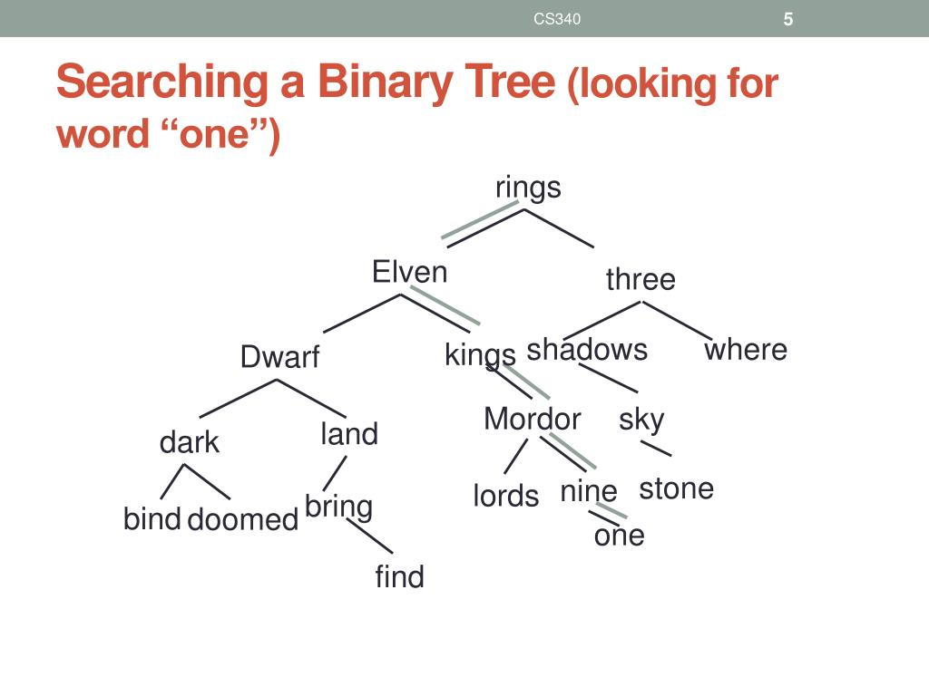

Slide 22
TIME AND SPACE COMPLEXITY
Time Complexity:
Best case : O(1) when the root node is same as root to be searched
Average case : O(logn) when any intermediate node is the node to be searched
Worst case : O(logn) when the leaf node is the node to be searched

Slide 23
TIME AND SPACE COMPLEXITY
Space Complexity:
In all cases only res , flag , and temp variable are made of constant size .ie. sizeof(int)
Best case : O(1)
Average case : O(1)
Worst case : O(1)

Slide 24
DELETION OF WORDS FROM THE DICTIONARY
This function is used to delete or remove the desired word from the dictionary using traversal.
Method : To delete a word from the dictionary (where words are stored in the form of a binary search tree), we first check the current word node, that is the root node of the tree. If the root node is null, we print on the console about its absence and the control of the program goes to the next executable statement. If the root node is not null, it implies we have at least one node or word present in the dictionary. We’ll iterate through the tree while we reach the leaf node and alongside we’ll search for the word to be deleted from the tree.If we’ll reach the leaf node without finding the word, a message will be displayed stating that the word to be deleted is not present in the tree. If the word is found, then three cases are possible to happen with the word to be deleted.

Slide 25
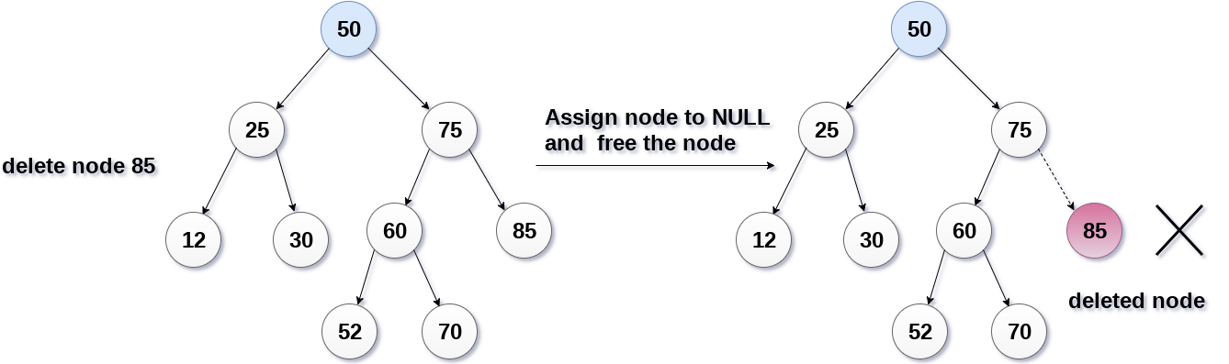
DELETION
To delete a word(node) from the dictionary, there are three different cases:
Word node is a leaf node.

Slide 26
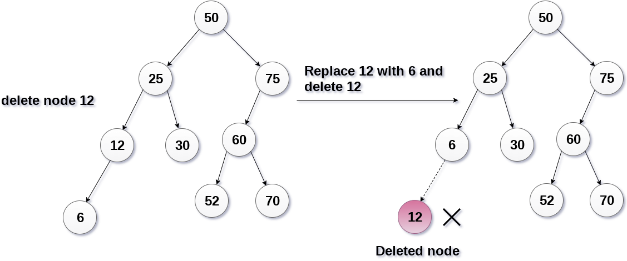
DELETION
To delete a word(node) from the dictionary, there are three different cases:
Word node has 1 children node

Slide 27
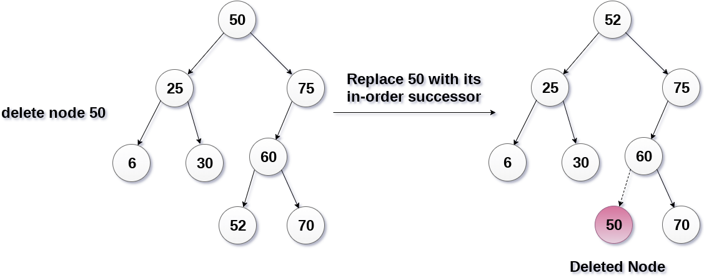
DELETION
To delete a word(node) from the dictionary, there are three different cases:
Word node has 2 children nodes
The inorder traversal of the tree :
6, 25, 30, 50, 52, 60, 70, 75.

Slide 28
TIME AND SPACE COMPLEXITY
The deletion function requires time proportional to the height(h) of the tree in the worst case that is O(logn) . It takes time to execute O(log n) in the average case and O(n) time in the worst case (in case of skewed binary search tree).
The space complexity for deleting a word from the tree is O(1).

Slide 29
TOTAL WORDS
This function gives total number of words in our Lexicon. It is a recursive function. The function first checks if the root is Null or not. If the root is not NULL, it counts the word at the root hence initializing total words equal to 1 and then recursively calls for counting total words for the left child as root and right child as root and add the results from these two recursive calls in total words and finally returns the total words.

Slide 30
ALGORITHM(PSEUDO CODE)
Total_Words(root)
if Root == NULL:
Return;
total_words = 1
total_words += Total_Words(root->left);
Total_words += Total_Words(root->right);
return total_words

Slide 31
TIME AND SPACE COMPLEXITY
Time Complexity of Total Words function is O(n) in both average and worst case.
Space Complexity of Total Words function is O(log(n)) in average case and O(n) in worst case.

Slide 32
EDIT EXISTING WORD
This functions asks the user to enter the word that requires editing. And then it gives users the choice to edit the required field and update the field according. And finally it prints the edited node(i.e meaning , antonym and synonym) for the given word.

Slide 33
ALGORITHM (Pseudo code)
void editWord(char * str)
Start from the root.
If root is null : print (empty lexicon)‘; return
Flag = 0 , temp node = root node
compare word with root
If cmp < 0 : search in left tree ( temp = temp->left )
If cmp > 0 : search in right tree (temp = temp->right )
If cmp = 0 : word found
a) choice to edit meaning,antonym or synonym using switch case.
b) get new antonym, synonym or meaning and update the same using strcpy.
c) print edited word with its meaning, synonym and antonym
cout<<"edited word is ";
cout<<"word: "<<str<<endl;
cout<<"Meaning: "<<temp->meaning<<endl;
cout<<"Synonym: "<<temp->synonym<<endl;
cout<<"Antonym: "<<temp->antonym<<endl;
Repeat 5 , 6 until condition 7 is reached iteratively
If ( flag = 0 ) ;
print ( word not found ) ;
return

Slide 34
TIME AND SPACE COMPLEXITY
Time complexity to edit an existing word is :
Average case: O(Log n )
Worst case: O(logn)
Space Complexity to edit an existing word is : O (1)

Slide 35
SUMMARY
Practical knowledge means the visualization of the knowledge, which we read in our books. For this, we perform experiments and get observations. Practical knowledge is very important in every field. One must be familiar with the problems related to that field so that he may solve them and become a successful person. The main objective of our project was to implement the Lexicon (dictionary) using the principal concepts of trees. Binary search Tree is the most efficient tree in terms of searching for a node, so we’ve covered it into a coherent framework. The dictionary is a real-life application where a person can look for words, their meanings, along with synonyms and antonyms, easily. We’ve gained a lot of knowledge and exposure in Data Structures from working on this project, be it concepts, team work, group discussion, innovation, optimization, debugging, testing and development. We also faced a lot of difficulties during the execution of the lexicon, be it errors, be it idea implementation, be it complexity. We’d like to take this project to a level above by adding file handling, etc. in the future.

Slide 36
FUTURE SCOPE
There are a number of directions to enhance the work presented here in this report and to explore new applications which involves trees, and for the ideas about extensibility presented here. Future work concerns deeper analysis of particular mechanisms, efficiency of algorithms in time and space, learning file handling, indexing in trees, using B trees, or B+ trees, or any other efficient m-way trees. New proposals to try different methods, or simply curiosity to develop applications which run on these algorithms. This has a very vast scope in the future.

Slide 37
THANK YOU !!

